Slide 1
Location of RF Signals with Direction of Arrival(DOA)
Albert Liu
Matthew Lumantas

Slide 2
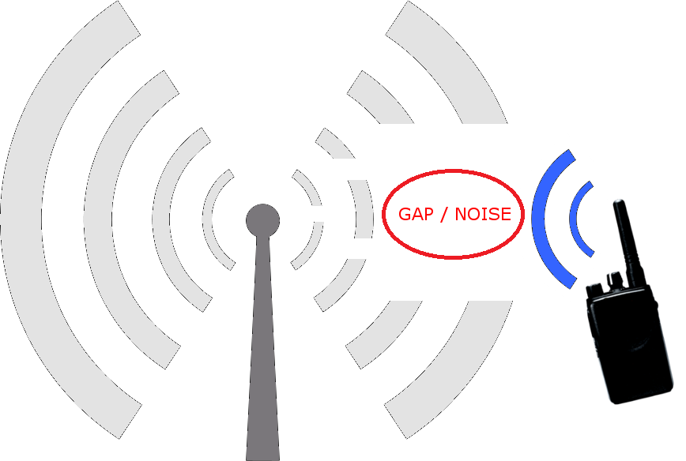
Problem
Rogue RF signals can cause interference with normal radio operation creating possible safety hazards and costly delays for projects
Location of the RF signals allows quick response for removing the interfering transmission
http://walltowallcomms.co.uk/index.php/blog/202-how-to-reduce-interference

Slide 3
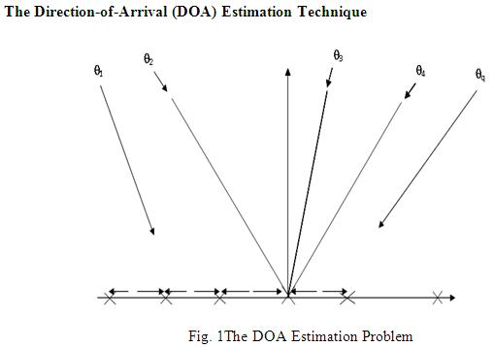
Objective
Use uniform linear array (ULA) of antennas to determine direction of arrival of unknown signal at a particular receiver
Beamforming, Maximum Likelihood Estimators, MUSIC, etc. are potential algorithms to achieve an accurate estimate
Correlate DOAs from multiple receivers to determine a probable transmission location of the signal
Optimizing the Performance of Modern Telecom Networks using a Novel Beam Sweep DOA method with LMS Algorithm in an Adaptive Smart Antenna

Slide 4
Computer
Computer
LabVIEW
LabVIEW
SDR
SDR
MIMO
MIMO
Phased Array
Phased Array
SDR
SDR

Slide 5
Phased Array
900 MHz carrier
16.665 cm (½ λ)
Receiver
LabVIEW
Angle Estimation
DOA Estimation
DOA Transmission
Amplifier
SDRs
Ethernet
Main Computer (for triangulation)
Ethernet

Slide 6
Labview Implementation
MATLab Simulation
Antenna Construction
Compare with Simulation
Prototype Testing

Slide 7
Schedule
Week 5 10/30/17 Matlab Simulation of Antenna and Phased Array
Week 6 11/06/17 Finalize Antenna Design and begin to order parts
Week 7-8 11/13/17 Develop Algorithm to estimate DOA and begin implementation into LabVIEW
Week 9 11/27/17 Antenna Construction
Week 10 12/4/17 Finish Antenna Construction and begin characterization
Winter Break 12/18/17 - 1/1/18 Catch up on any unfinished tasks
Week 1 1/08/18 Iterate on Antenna Design
Week 2 1/15/18 Finish Antenna Characterization and assembly of prototype
Week 3 1/22/18 Fine-tune prototype and estimation algorithms
Week 4 -5 Overflow time/ Further reliability testing

Slide 8
Task Division
Albert Liu | Matt Lumantas
Phased array antenna Matlab simulation DOA estimation Matlab simulation PCB Design for Phased Array Characterization of Phased Array Antenna Prototype testing | Create beamforming/DOA algorithm in LabVIEW Design circuit for pre-amp at antenna elements Construct antenna array Interface receivers with LabVIEW Prototype testing

Slide 9
Questions?

